Slide 1
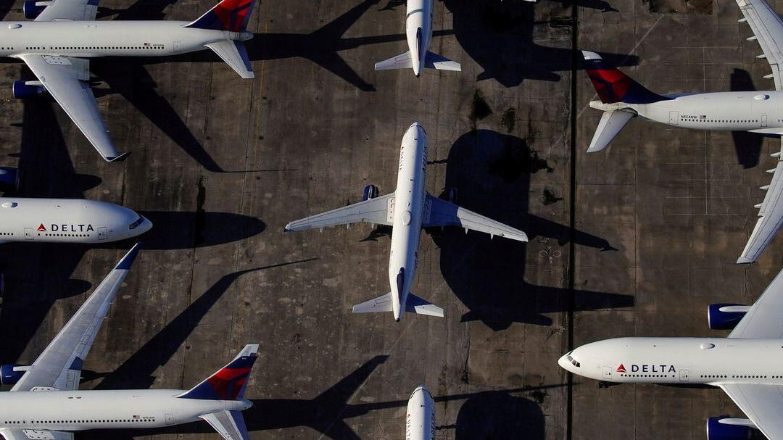
Analyzing the Correlation Between Oil Prices and Airfare
Group 5

Slide 2


Introduction
Correlation between airfare and crude oil prices.

Slide 3
Business Questions
How do airlines deal with changes in oil prices and their effect on finances?
How do changes in oil prices affect the costs and profits of airlines?

Slide 4

Data set and Data sources

Slide 5
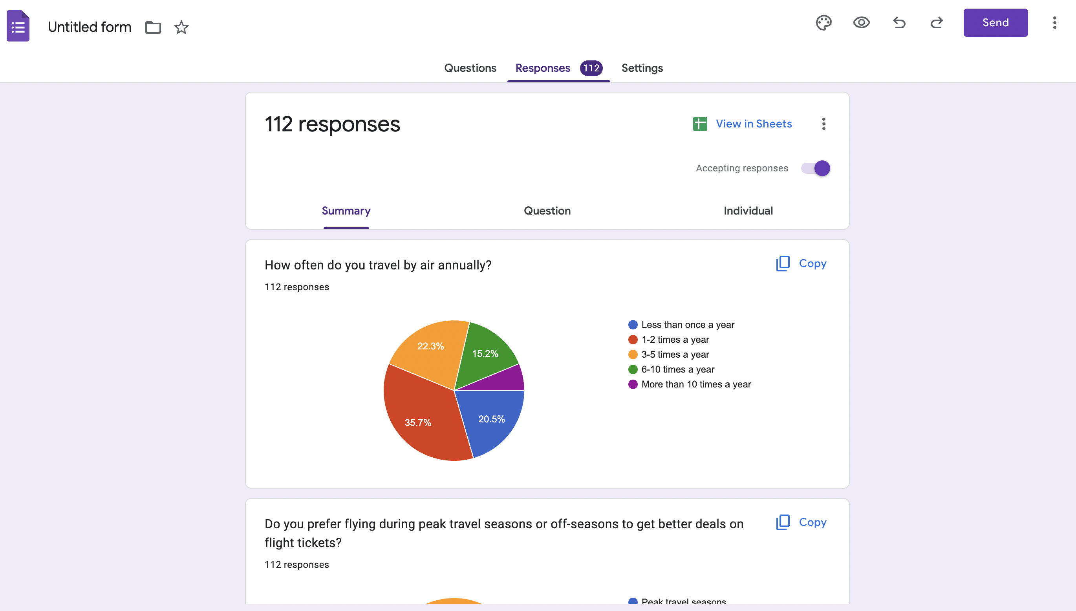
Primary Data And Secondary Data
Primary
Secondary
oil prices : Macro-Trade
US Airline Data :US Energy Administration
Indian Airline Data : Kaggle

Slide 6

Data Wrangling Process
Step 1
Step 1
Data Discovery
Step 2
Step 2
Data formatting (Date Formatting, Data types)
Step 3
Step 3
Data Profiling (Data Patterns, column profiling)
Step 4
Step 4
Data Preprocessing (Handling Missing and Null values, Outliers, Removal of columns)

Slide 7
Data Wrangling Process
Step 5
Step 5
Merging Datasets
Step 6
Step 6
Statistical Analysis
Step 7
Step 7
EDA, Visualization
Step 8
Step 8
Modelling with linear Regression

Slide 8
Challenges
Merging and joining data from multiple sources
Dealing with outliers
Data standardization
Handling missing values
Currency conversion
Data quality and accuracy

Slide 9
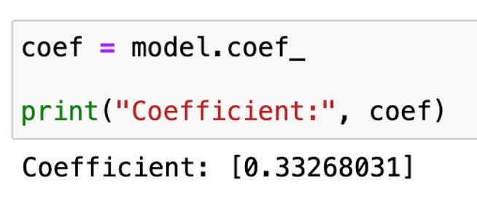
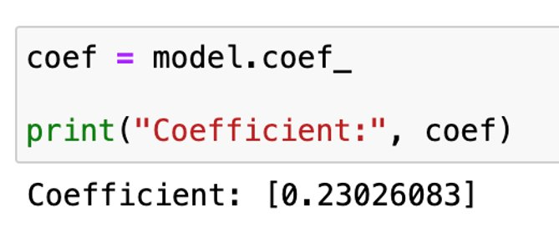
Findings
US AIRLINES
INDIAN AIRLINES

Slide 10
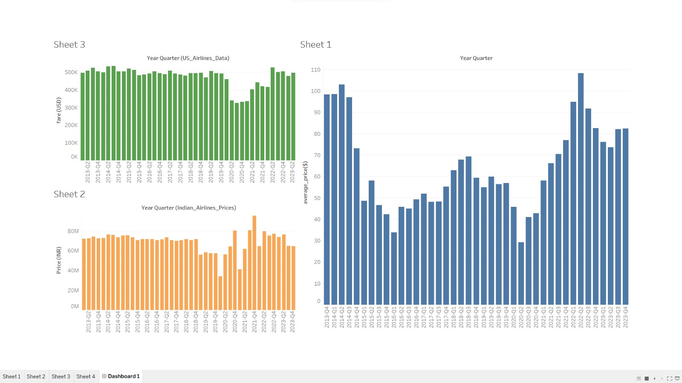
Dashboards

Slide 11
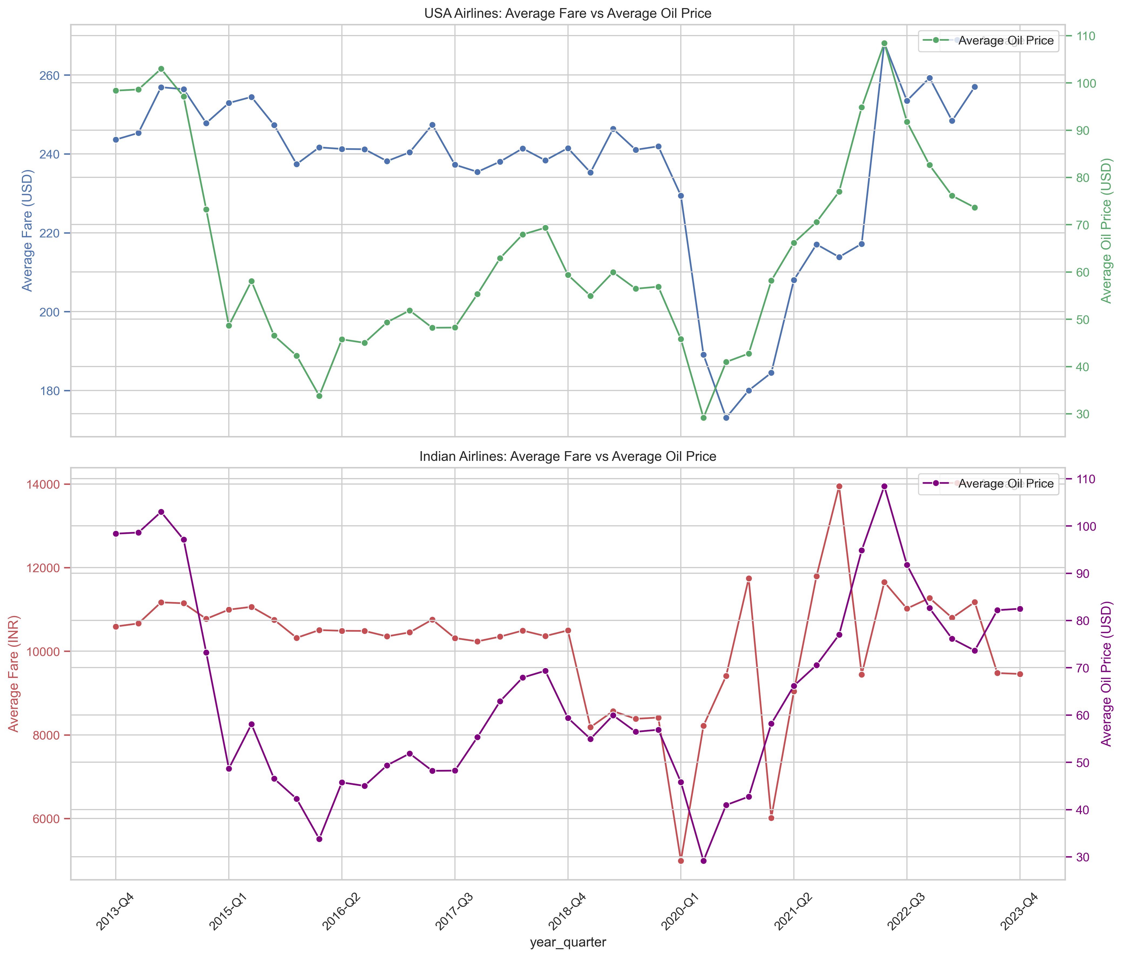
VISUALISATION

Slide 12
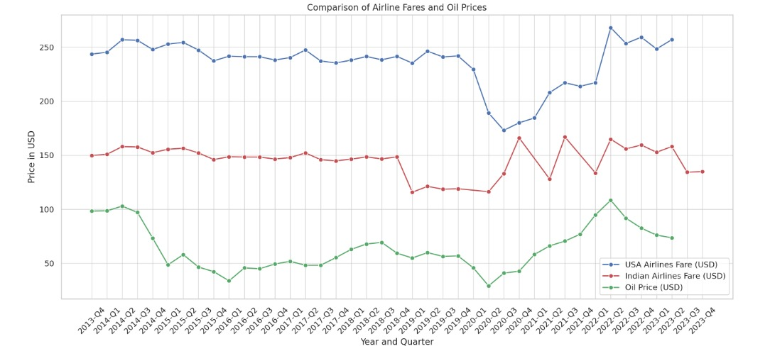
The chart illustrates the fluctuations in prices over time, allowing for a comparison of trends between airline fares in the US and India against the backdrop of oil price changes. The overall trend for each line can provide insights into how sensitive airline fares in both countries are to the changes in oil prices.

Slide 13

Uniqueness
Data collection and integration
Diverse operational models
Currency and economical factors
Complex correlation analysis

Slide 14

Final Analysis
Oil Price Correlation
While there is a visible relationship between oil prices and airline fares, it's not a one-to-one correlation, indicating the influence of additional factors.
Stability vs. Volatility
US airlines show stable fare trends with minor fluctuations, whereas Indian airlines display greater volatility in response to oil price changes.
Market Dynamics and Operational Factors
Different market dynamics and operational practices, such as fuel hedging, may buffer the impact of oil price changes on airline fares.
Regional Market Responses
The Indian airline market shows a stronger response to oil price fluctuations compared to the US market, potentially due to differing market scales and regulatory environments.

Slide 15
Thank You

